Slide 1
Weather forecasting website
Submitted To : Mr. farhan
Submitted by : Vibhansh Agrawal, Ishan, Saksham Verma
University Name : GLA University
Department Name: CEA(Computer Engineering and Application)
Date: 4-12-23

Slide 2
Introduction
The need for accurate weather forecasting
Weather profoundly impacts our daily lives, from planning outdoor activities to crucial decisions in various industries.
It is very much needed to get an accurate weather forecasting of a particular city.

Slide 3
Our goals
Enhancing Accessibility:
Our primary objective is to democratize weather information by providing a user-friendly platform accessible to individuals from diverse backgrounds.
Precision and Reliability:
We strive to deliver forecasts that are not only accurate but also timely.

Slide 4
Addressing Critical Challenges
Inconsistent and Inaccurate Forecasts:
Traditional weather forecasting systems often struggle with inconsistencies and inaccuracies, leading to unreliable predictions.
Limited Accessibility to Reliable Forecasts:
Access to accurate weather forecasts is unevenly distributed, with certain regions or demographics having limited or no access to reliable predictions.

Slide 5
Understanding the Landscape
User Expectations and Demands-
Users seek real-time updates tailored to their specific locations, activities, and interests.
This trend emphasizes the need for weather forecasting platforms that cater to individual preferences and provide detailed, relevant information

Slide 6
Methodology
API-Driven Data Integration:
Our methodology relies on leveraging APIs to gather real-time weather data from trusted sources.
These APIs provide us with a diverse range of meteorological information, including temperature, humidity, wind speed, and precipitation forecasts.

Slide 7
System Architecture
API Integration
User Interface
Forecast

Slide 8
Implementation
Technology Stack:
Our implementation leverages foundational web technologies such as HTML, CSS, and JavaScript.
These core languages form the backbone of our platform, allowing us to create a dynamic and responsive user interface.

Slide 9
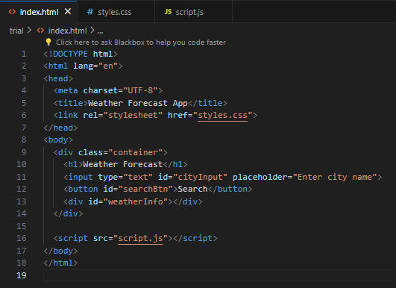
HTML code
Basic structure
Search for city input box and button
Linking of CSS
Linking of JS

Slide 10
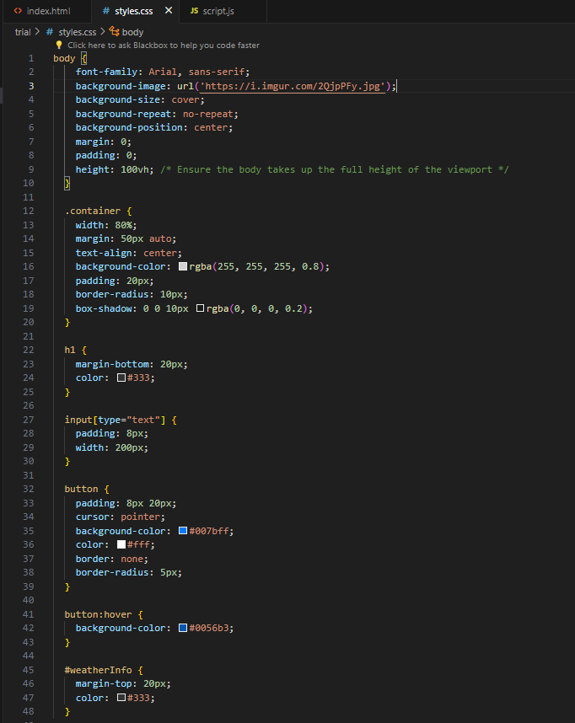
CSS code
Flexbox
Adding background image
Making box for input and displaying result

Slide 11
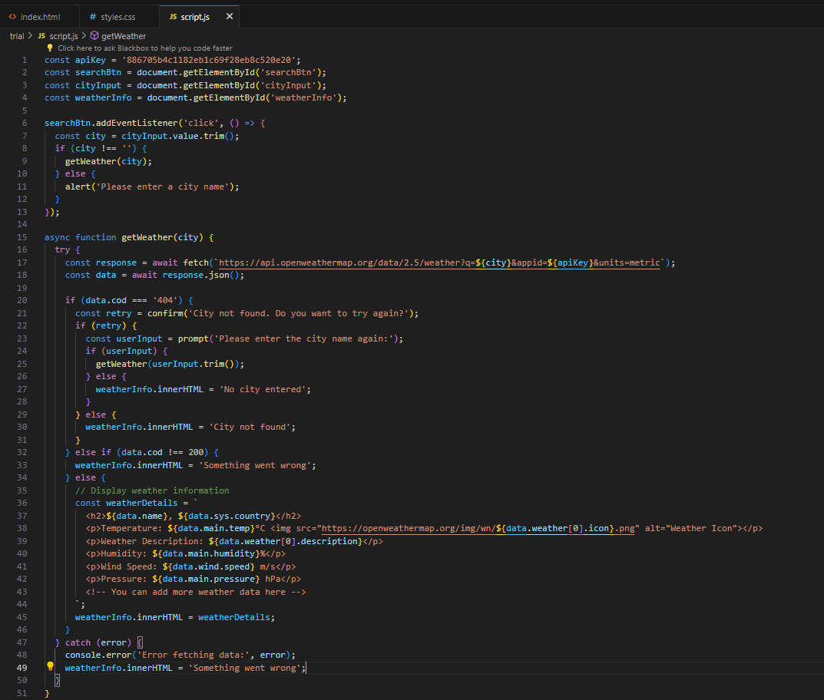
JavaScript Code
Weather object
Fetch API
Weather display with details
Error display

Slide 12
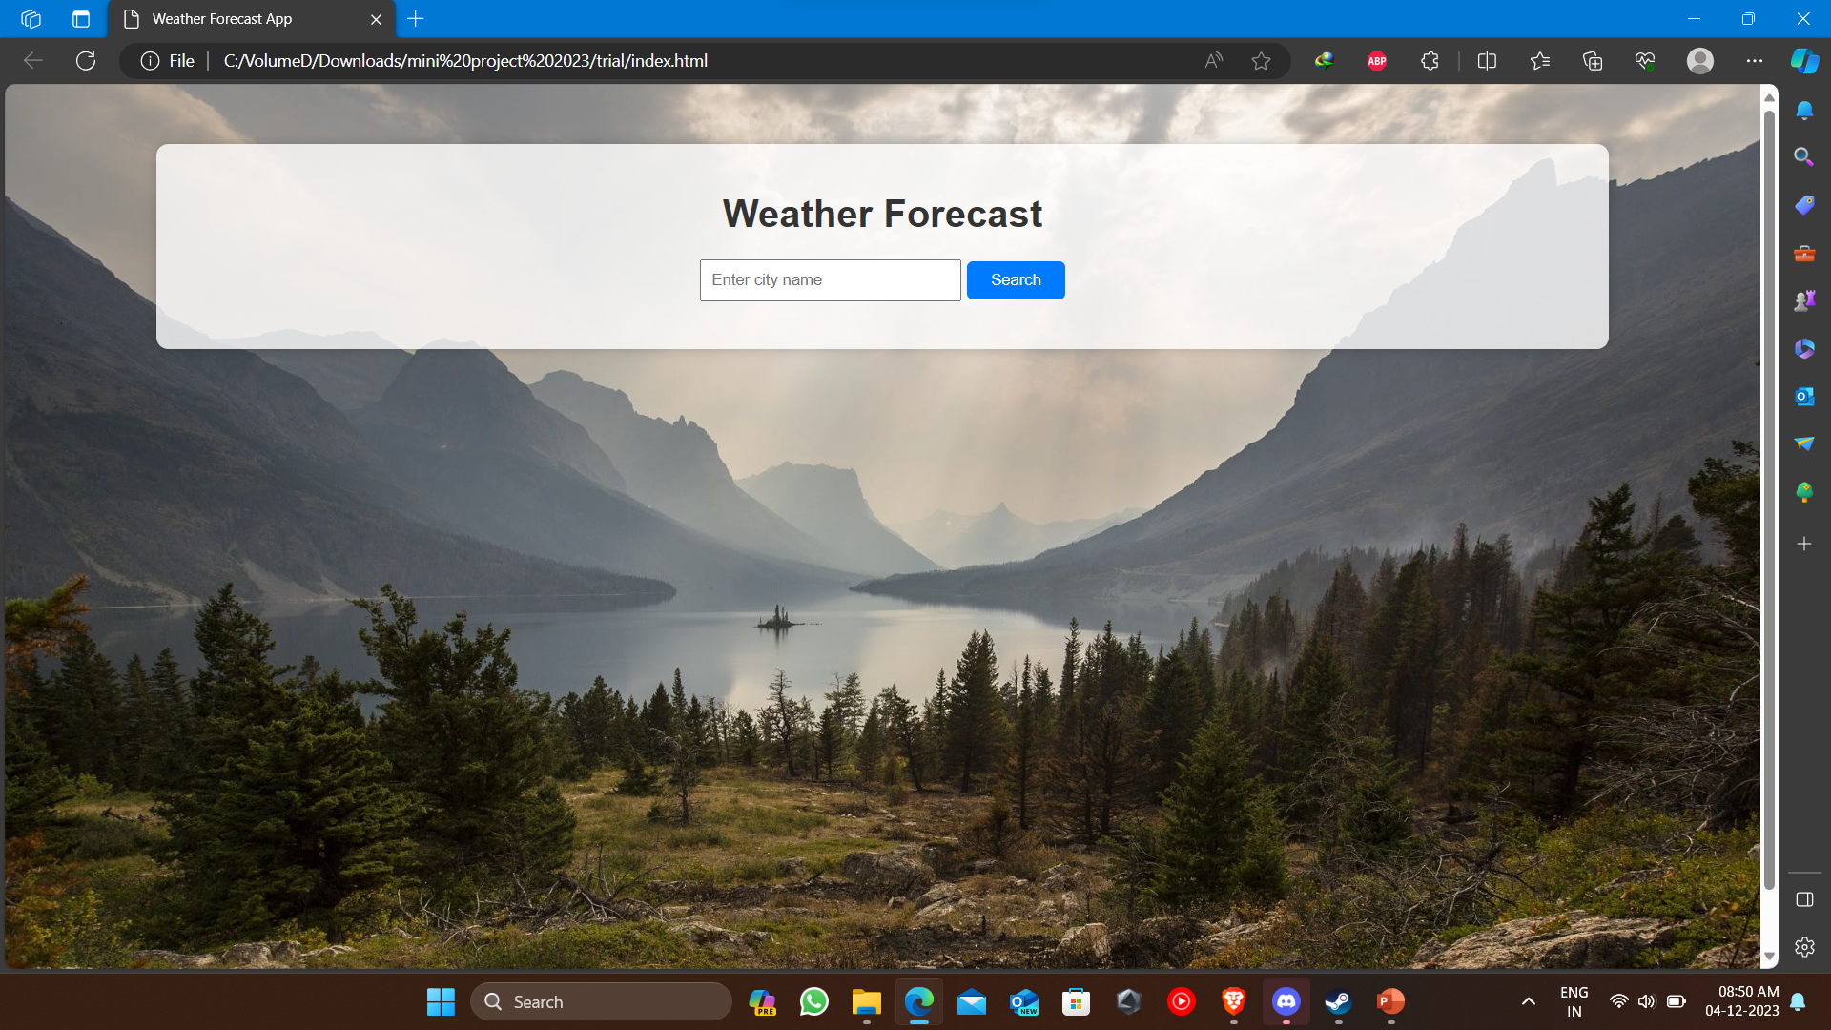
Screenshot

Slide 13
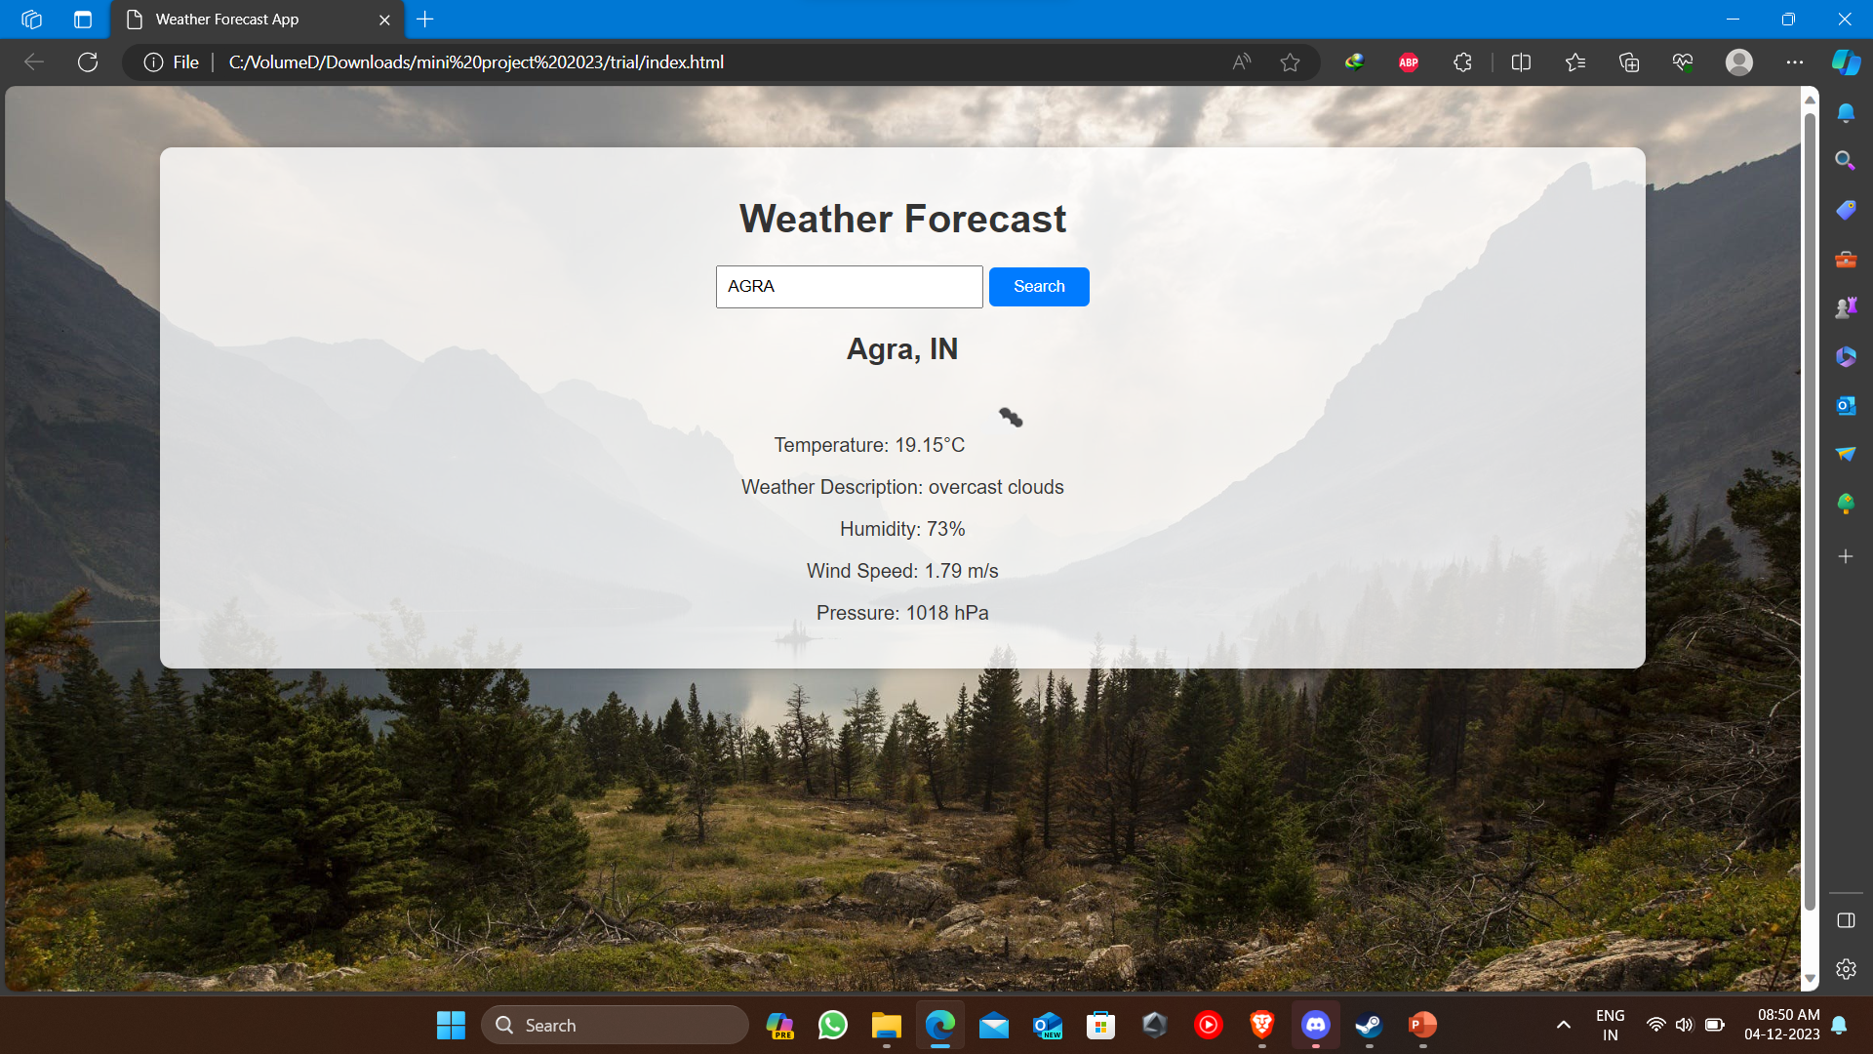
Screenshot

Slide 14
Features
Responsive Design
Attractive Styling
Real-time Background Update

Slide 15
Project Accomplishment
Dynamic Weather Display
Fetching Weather Data
Displaying Weather Information
Background Image Update
User Interaction

Slide 16
Conclusion and Takeaways
Importance of secure API key handling.
Significance of error handling and validation.
Emphasis on responsive design
Continuous maintenance for a smooth user experience.
Design
Attractive Styling
Real-time Background Update

Slide 17
Acknowledgments
Thanks to our Mentor Mr. Farhan sir
Thanks to our Subject teacher Mr. Govind Jha sir
Geeksforgeeks - https://www.geeksforgeeks.org
And Many More

Slide 18
THANK YOU

